Slide 1
Bangalore water management
Name:Thinesh.T
Roll no:71382006045
Domain :Data Analyst
HR Name: Mrs. Priya
College: SRI RAMAKRISHNA INSTITUTE OF TECHNOLOGY

Slide 2
Topics
Introduction
Importance of Water Management
Water Bodies used to Analyse Water Management
Output
Conclusion
References

Slide 3
Introduction
Bangalore, the bustling capital city of Karnataka, India, stands as a beacon of innovation and development in the country. Its rapid growth, fuelled by the IT boom and urbanization, has transformed it into a vibrant metropolis. However, amidst its glittering skyline lies a pressing concern – water management. Bangalore faces formidable challenges in ensuring the availability, accessibility, and sustainability of its water resources. From dwindling groundwater levels to pollution of lakes and rivers, the city grapples with a multifaceted water crisis exacerbated by population growth and climate change. As Bangalore navigates its journey towards becoming a global hub, the effective management of its water resources emerges as a critical imperative for sustainable development and resilience. This document delves into the current state of water management in Bangalore, outlining key challenges, existing practices, innovative solutions, and recommendations for a water-secure future.

Slide 4
Importance of Water Management
Water management plays a critical role in ensuring the sustainable use and availability of one of our most precious resources: water. Effective water management is essential for addressing numerous global challenges, including water scarcity, pollution, and climate change impacts. By implementing efficient water management practices, we can ensure equitable access to clean water for present and future generations while also supporting ecosystems and economic development. Proper management involves strategies for conserving water through efficient use and minimizing waste, treating water to maintain quality standards, and distributing it effectively to meet various needs. Additionally, water management policies and regulations help govern usage, protect water sources, and promote sustainable practices. In essence, prioritizing water management fosters resilience against environmental pressures, enhances community well-being, and safeguards the health of both people and the planet. Ultimately, recognizing the importance of water management is crucial for fostering a sustainable future where water resources are preserved and utilized responsibly.

Slide 5
Water Bodies used to Analyse Water Management
ABBIGERE LAKE
AGARA LAKE
AKSHAYANAGARA LAKE
ALLALASANDRA LAKE

Slide 6
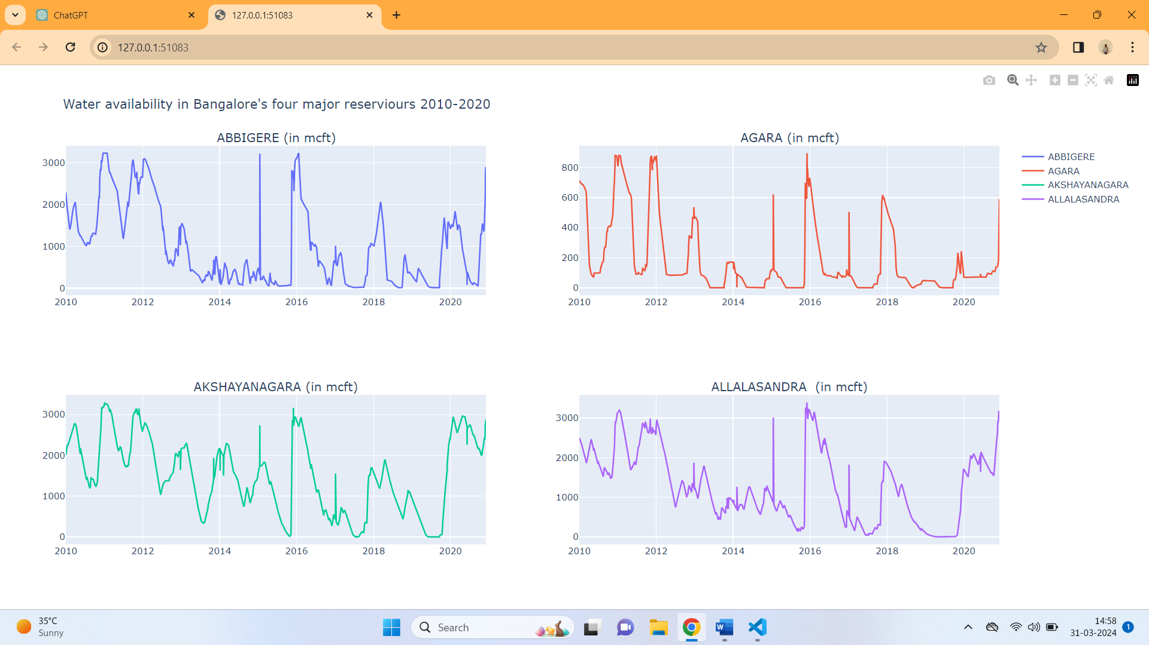
Output

Slide 7
Conclusion:
In conclusion, water management in Bangalore is a complex and pressing issue that requires urgent attention and concerted action from all stakeholders. The city's rapid urbanization, coupled with environmental degradation and climate change, has placed immense strain on its water resources, leading to scarcity, pollution, and inequitable distribution.

Slide 8
References
http://kaggle.com/

